Slide 1
Art Performance Proposal
Rafi Izzatul Rizqu Faris
XII RPL 1

Slide 2
Background
One of the creativity and wealth of the nation that needs to be preserved is art. It should be that existing art is developed in such a way that it does not become extinct. One way that can be done to develop art is to schedule an art performance. Therefore, the student council board of SMA Negeri 1 Talun was about to hold an one-school art performance.
The purpose of the art performance was to increase people's love and appreciation for art. Also to grow the best artists. That's why we feel the need to hold an agenda with the theme "Performing Arts Today".

Slide 3
Theme, Activities, and Participant
This activity takes the theme "Performing Arts Today", so that the interest of students and students is increasing in the arts.
The contents of this activity are:
• Performing arts of music
• Drama
• Band festival
Participants of this art performance are all students of SMA Negeri 1 Talun who will be divided into each class.

Slide 4
Time and Place, Tools Required
The time and place to carry out its activities are:
Music art performance: Sunday morning
Drama: Sunday Afternoon
Band Festival: Sunday Night
Some of the tools needed are:
Costumes
Stage
Banners
Attributes

Slide 5
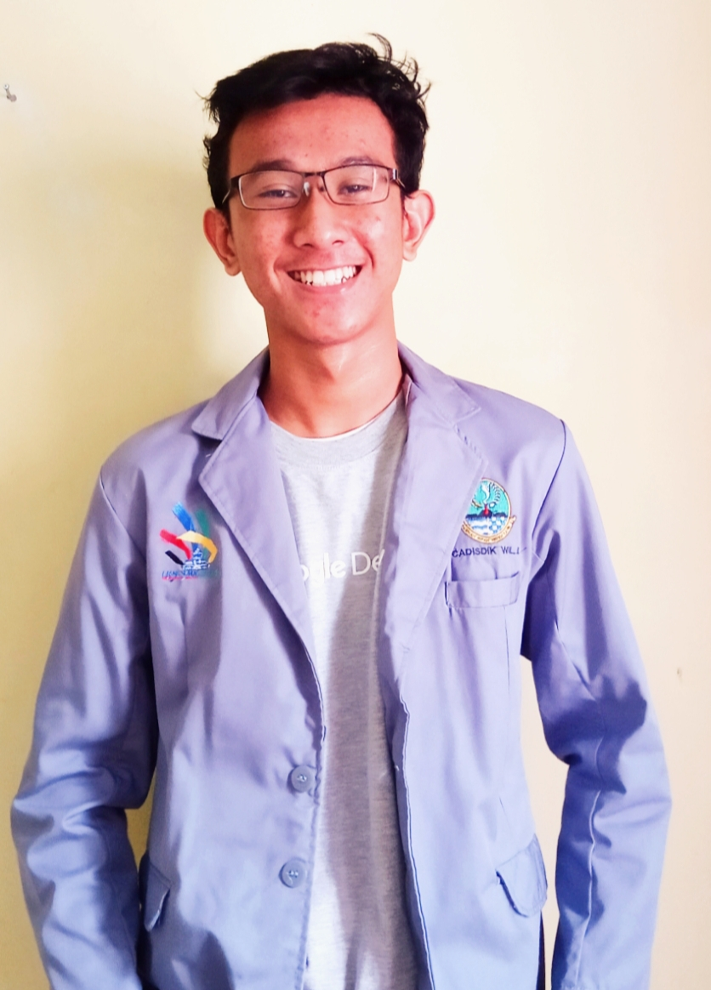
We look forward to active participation from all parties for the smooth running of this event going forward. For your attention,
thank you.

